Slide 1
Introduction to StructureMap
Levi Hinze

Slide 2
What is StructureMap?
IOC Container
Dependency Injection
Dependency Inversion principle [1]
High-level modules should not depend on low-level modules. Both should depend on abstractions.
Abstractions should not depend upon details. Details should depend upon abstractions.
Notes:
IoC stands for Inversion of Control
IoC inverts the flow of a program so that instead of writing custom code that calls a generic library, the generic library calls the custom code to fill in the blanks. That’s kind of a hard idea to think about, but an example of this is ASP.NET MVC.
StructureMap uses Dependency Injection to implement Inversion of Control.
Examples are Property injection and Constructor injection.
Dependency Injection allows you to follow the Dependency Inversion principle. Instead of relying on the implementation, you can rely on the interface.
Your modules will be loosely coupled.
Dependency Inversion is the last principle in the SOLID principles.
Single responsibility principle
a class should have only a single responsibility (i.e. only one potential change in the software's specification should be able to affect the specification of the class)
Open/closed principle
“software entities … should be open for extension, but closed for modification.”
Liskov substitution principle
“objects in a program should be replaceable with instances of their subtypes without altering the correctness of that program.” See also design by contract.
Interface segregation principle
“many client-specific interfaces are better than one general-purpose interface.”
Dependency inversion principle
one should “Depend upon Abstractions. Do not depend upon concretions.”

Slide 3
Why should you care?
Easier to Maintain / Refactor
Loose Coupling
Testability
Results in Better Architecture
Notes:
These should also be reasons why your employer should care too.

Slide 4
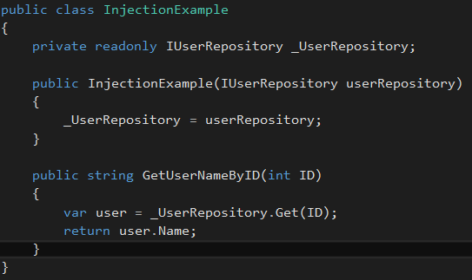
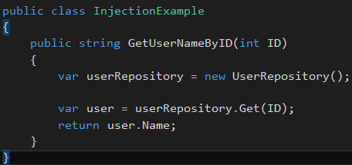
Dependency Injection
Notes:
Left side doesn’t use dependency injection.
If we need to make a change to UserRepository so that the constructor takes an argument for a logging class, then we’d need to update the InjectionExample class too.
The example on the right uses dependency injection, and would not need to be updated if we added an argument to the constructor of UserRepository.
Mention object graph here.

Slide 5
Demo

Slide 6
Links
http://structuremap.github.io/
http://martinfowler.com/articles/injection.html
https://github.com/lhinze/DNUGStructureMapExamples

